Slide 1
420-D04-SU
Object-oriented programming I Java I
Threads

Slide 2
Definition: Process
A process is a program that executes and that possesses its own memory space and resources: its own registers, stacks, variables
P2
Operating system (OS)
We have three processes here in our operating system
P1
P3

Slide 3
Definition: Thread
A thread is a part of the instructions of a process in the course of execution (light process).
A process can contain one or multiple threads that execute quasi-simultaneously, or simultaneously on multi-core processors.
The threads in a process share the same resources and the same memory space.
P3
T1
T2
T3

Slide 4
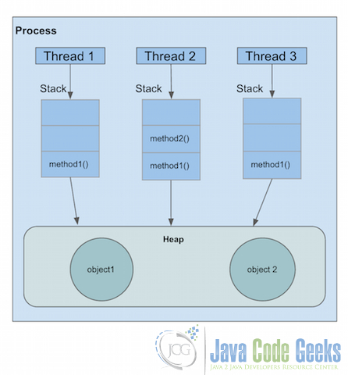
Processes and threads
A Stack is created for each Thread
In programming, we are in general particularly concerned with threads.
It is possible to manage processes if we make an application that is very resource-intensive (using multiple cores)

Slide 5
Problem
Like we saw in the previous diagram, the threads share the same heap.
If two threads try to access the same object at the same time, we can have a problem of synchronization.
There exist procedures in Java for synchronizing threads.

Slide 6
JVM threads
Java uses a scheduler
The Java scheduler manages the threads in a random fashion.
run a thread for a certain time,
then another,
then come back to the first,
etc…
The interrupted thread is put to sleep while the other is awake.

Slide 7
Thread states:
NEW : Upon creation.
RUNNABLE : When we invoke the start() method, the thread is ready to execute.
TERMINATED : When the thread has performed all of its tasks: it has been “killed”. You can no longer relaunch it with the start() method.
TIMED_WAITING : While the thread is temporarily paused. (When you use the sleep() method, for example.)
WAITING : While the thread is paused indefinitely.
BLOCKED : When the scheduler pauses a thread in order to use another, it imposes this state.
We can display the state of our thread by using the getState() method.

Slide 8
Threads and JVM
When you start a Java program, 3 threads are started:
The main thread, which executes the main method;
The garbage collector thread;
The EventDispatchThread (manages GUI)
Everything concerning the graphical user interface must be executed in this thread.
In the case of a user thread, these must be synchronized.

Slide 9
Runnable interface
This interface must be implemented by all classes that contain some processing to be executed in a thread.
This interface defines only a single method (functional interface): void run().
Redefine run() to implement the processing to be executed.

Slide 10
Thread class
Defined in java.lang
Implements Runnable interface
Multiple constructors
Thread(String name)
Thread(Runnable name)
Thread(String group)
Call the start() method to initiate a Thread.

Slide 11
Methods on threads
.start() Start a thread
.wait() Pause a thread
Thread.sleep(long milliseconds) : only for the currently executing thread
.notify() Wake up a thread
.notifyAll() Wake up all threads
.run() Thread method containing the threads tasks to be executed.

Slide 12
Creating a thread: 2 strategies
Strategy 1: Create a class that inherits from Thread
Redefine the run() method, which will be called after start() is called.
The class:
class MyThread extends Thread
{
public MyThread() {
System.out.println("Initializing the thread");
}
@Override
public void run() {
System.out.println("Executing the run() method of the thread");
}
}
The main:
public static void main(String[] args) {
MyThread t1 = new MyThread();
t1.start();
}

Slide 13
Creating a thread: 2 strategies
Strategy 2: Create a class that implements the Runnable interface:
class MyRunnableThread implements Runnable{
public MyRunnableThread() {
System.out.println("Initializing thread");
}
@Override
public void run() {
System.out.println("Executing the run() method of the thread");
}
}
In the main:
Thread t2 = new Thread(new MyRunnableThread());
t2.start();

Slide 14
Runnable with anonymous class
Thread t = new Thread(new Runnable() {
int x = 0;
@Override
public void run() {
System.out.println(x);
x++;
if (x < 10)
run();
}
});
t.start();
Thread t = new Thread(new Runnable() {
int x = 0;
@Override
public void run() {
while (x < 10) {
System.out.println(x);
x++;
}
}
});
t.start();

Slide 15
Critical sections
A critical section is a block of code that should not be executed simultaneously with another block of code.
We use the following syntax:
synchronized (myLock)
{
}
Where myLock is an object of whatever type.
Enables waiting for the lock to be free before executing the code.

Slide 16
Synchronized methods
public synchronized void myMethod()
{
}

Slide 17
Monitoring threads
wait(), notify(), notifyAll(), inherit from Object, and require the use of synchronized in order to be used.
wait() and notify() cannot be executed at the same time.

